Slide 1
Overview of F&B Flavors in North America
“Exploring a Flavorful Decade: Unveiling 797 Distinct Flavors that Defined North American Tastes from 2001 to 2010”

Slide 2
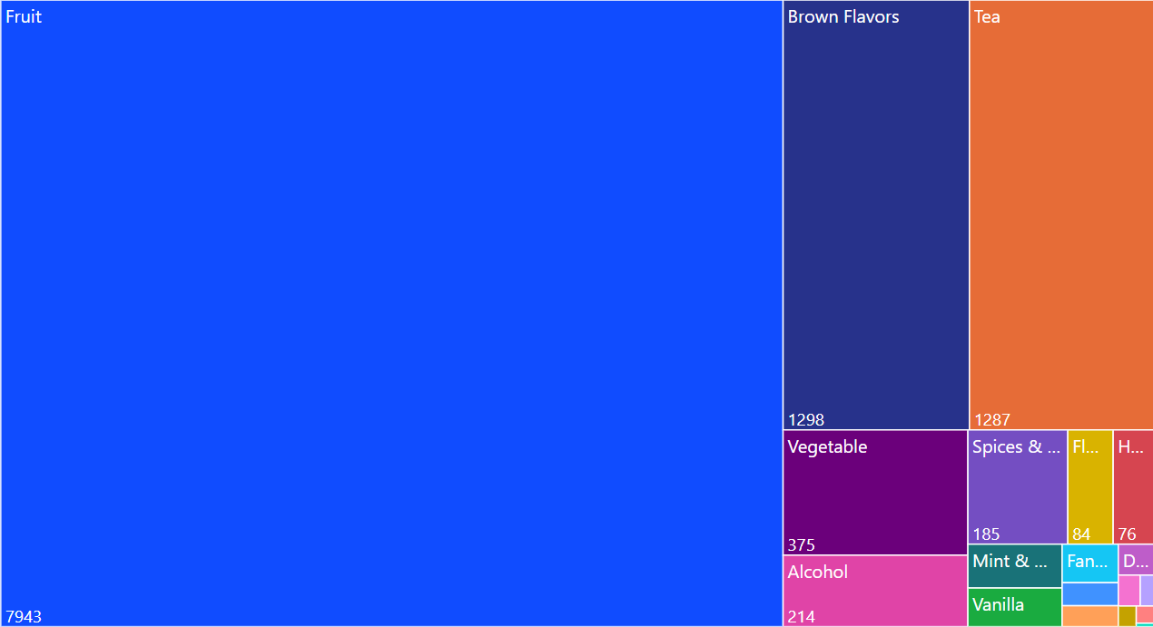
Top-Used Flavor Groups in North America (2001-2010): A Decade of Flavor Trends

Slide 3
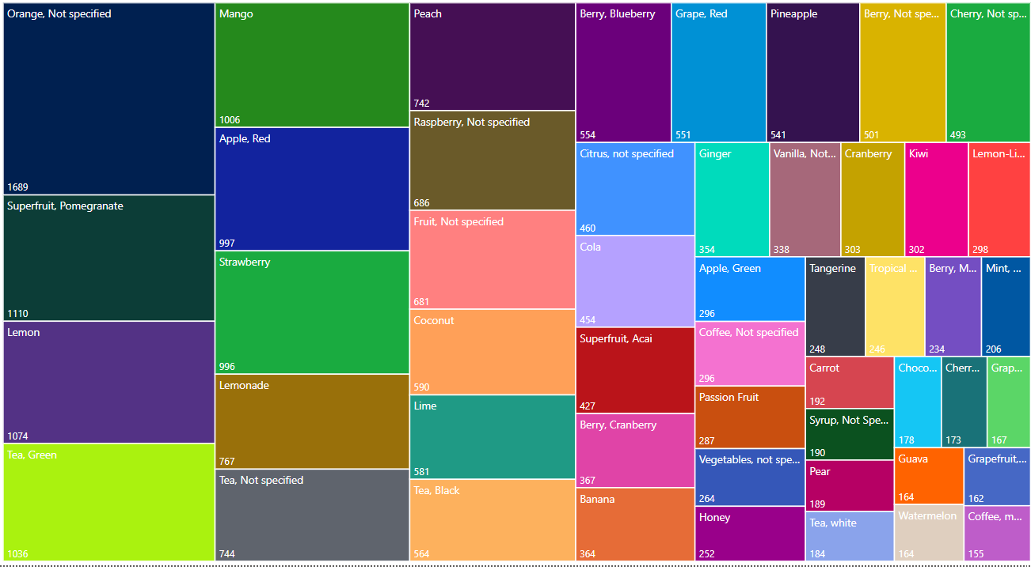
Top Used Flavors in North America (2001-2010)
SQL Query
WITH FlattenedFlavors AS (
SELECT
TRIM(PARSENAME(REPLACE(Flavor, ';', '.'), 2)) AS Flavor1,
TRIM(PARSENAME(REPLACE(Flavor, ';', '.'), 1)) AS Flavor2,
TRIM(PARSENAME(REPLACE(Flavor, ';', '.'), 3)) AS Flavor3,
*
FROM
[Product Launch Dataset$]
WHERE
Region = 'North America'
)
, AllFlavors AS (
SELECT Flavor1 AS Flavor, YEAR([Launch Date]) AS LaunchYear FROM FlattenedFlavors
UNION ALL
SELECT Flavor2, YEAR([Launch Date]) FROM FlattenedFlavors
UNION ALL
SELECT Flavor3, YEAR([Launch Date]) FROM FlattenedFlavors
)
SELECT TOP 50 TRIM(Flavor) AS Emerging_Flavors, COUNT(*) AS No_of_Flavor
FROM AllFlavors
WHERE
Flavor IS NOT NULL AND Flavor NOT IN ('Unflavored', 'na')
GROUP BY Flavor
ORDER BY No_of_Flavor DESC;

Slide 4
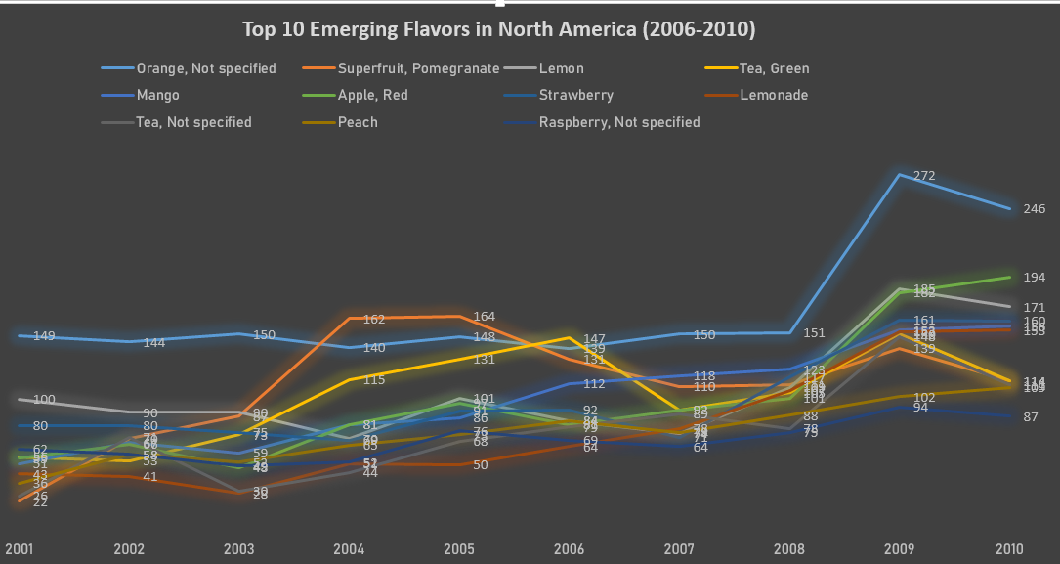
The Top 10 Trending and Emerging Flavors in North America (2001-2010)"

Slide 5
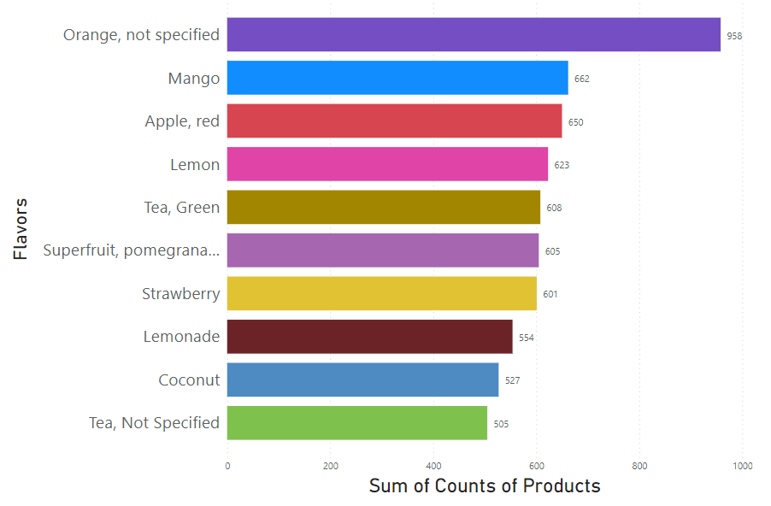
Top 10 Used Flavors in North America (2006-2010)

Slide 6
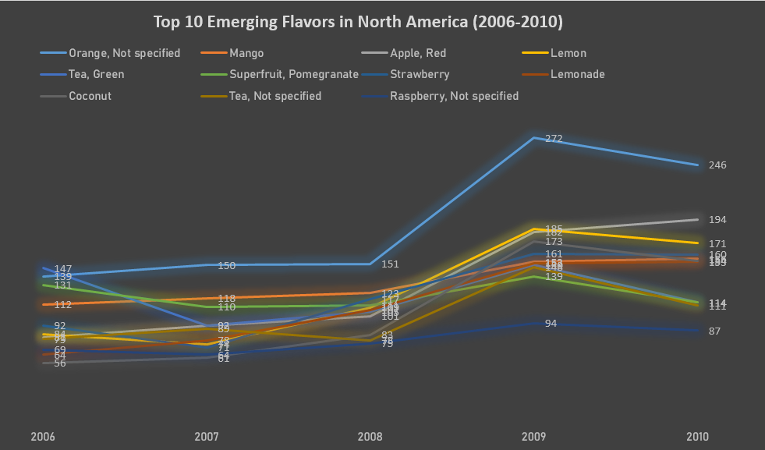
Top 10 Emerging Flavors in North America (2006-2010)

Slide 7
Decision-Making for Brand Manager

Slide 8
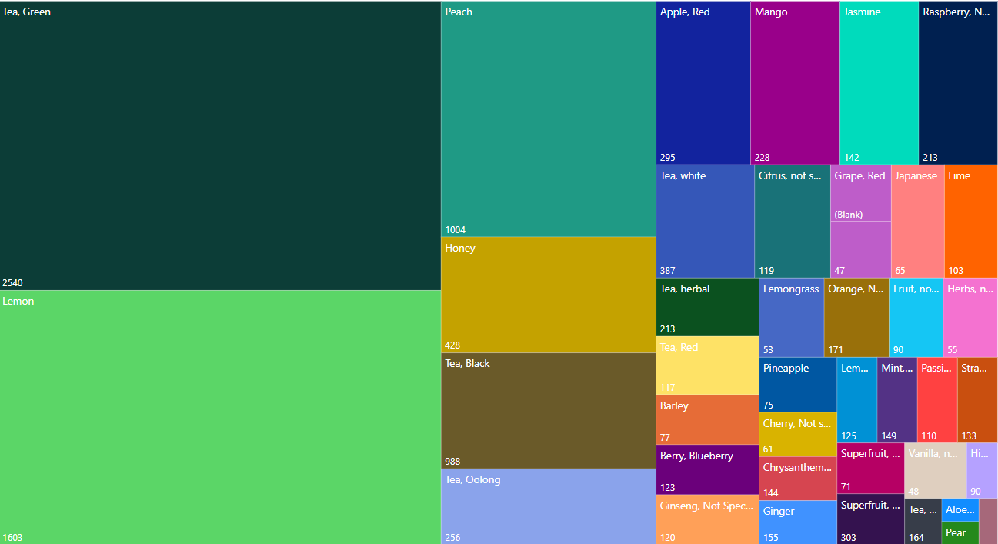
Top Used Flavors in Iced Tea (2000-2010)

Slide 9
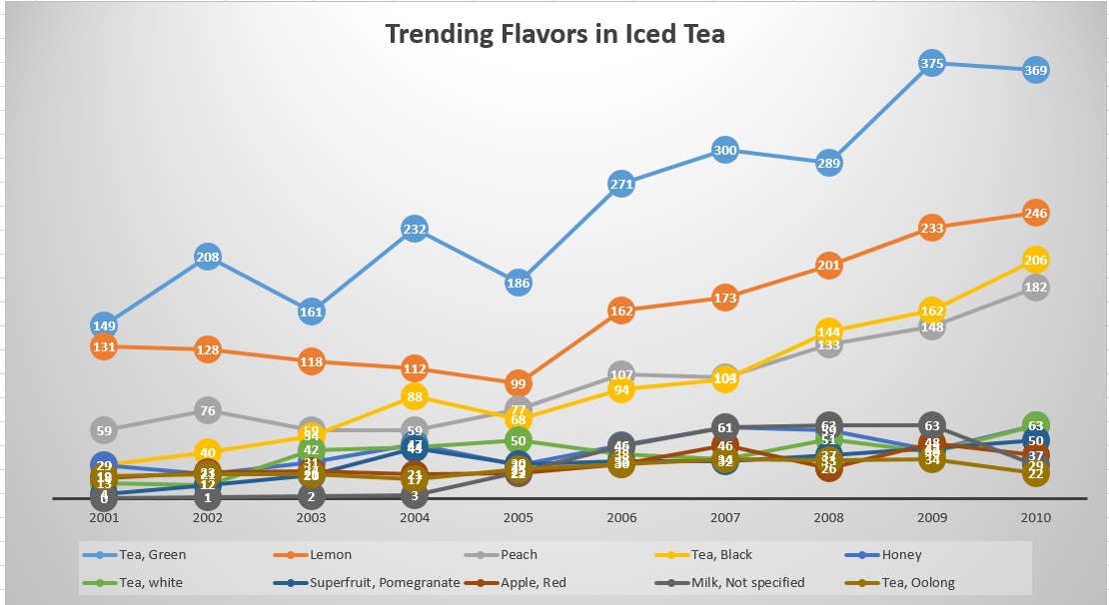
Top 10 Trending Flavors in the Iced Tea Segment

Slide 10
Exploring the Least Used Iced Tea Flavors in North America (2000-2010)
Wax Jambu | Menthol | Spices, Multi | Cappuccino | Brambleberry | Burdock | Fenugreek | Ginger Ale | Fruit, Camu Camu
Apple, Golden | Chocolate, milk | Cake, Blackforest | Nata De Coco | Tea, Kabuse | Cream, whipped | Bamboo Shoot | Honey Fungus | Longan
Superfruit, Gooseberry | Yeast | Juniper | Berry, Moringa | Nut, Walnut | Nut, Cashew | Beetroot | Toffee | Wasabi
Superfruit, pawpaw | Mushroom, Not specified | Grape,red | Curcumin | Orange, Valencia | Bean, red | Loquat | Tumeric | Superfruit, Kumquat
Rice, black | Broccoli | Grains, Chia | Medlar | Tiramisu | Cider, Apple | Sweetsop | French | Masala
Barbados Cherry | Milk, Coconut | Wine, chardonnay | Potato, Purple | Mabolo | Aniseed | Corn, Roasted | Ube | Malt
Chocolate, dark | Bean, Mung | Currant, Not Specified | Tarragon | Coffee, Latte macchiatto | Tea, | Superfruit, yumberry | Water Chestnut | Nutmeg
Thyme | Lime, key | Mint, Black | Grapefruit, red | Tequila, Not Specified | Kale | Bluecurrant | Cherry, Sour | Cayenne
Superfruit, Cloudberry | Star Anise | Custard | Nut, Hazelnut | Bean, Cocoa | Rum, Not Specified | Feijoa | Cooling Sensation | Dandelion
Cider, Not Specified | Mango, Green | Anise | Sugar, White | Rice, Jasmine | Fennel | Berry, Aronia (Chokeberry) | Tea, Senna | Nut, Chestnut

Slide 11
Market Exploration and Consumer Insights
For gaining a deep understanding of the market and consumer preferences to inform the decision on launching a new iced tea variant.
Gaining Consumer Insights:
Utilize market research and surveys to understand consumer preferences, behaviors, and trends related to iced tea consumption.
Field Visits for Direct Insights:
Engage with consumers through salesperson visits to gather real-time feedback, preferences, and expectations.
Competitive Analysis:
Analyze competitors' product offerings, pricing strategies, marketing campaigns, and consumer feedback.
Market Segmentation Design:
Identify and segment the market based on demographics and geographic areas to tailor the product to specific consumer groups.

Slide 12
Strategic Analyses and Decision-Making
Key Analyses:
Demographic-Based Analysis:
Understand consumer demographics to define the target audience for the new SKU.
Porters Five Forces Analysis:
Assess industry competitiveness through analysis of buyers, suppliers, new entrants, substitutes, and rivalry.
PESTLE Analysis:
Evaluate external factors such as political, economic, social, technological, legal, and environmental influences.
Competitor Analysis:
Analyze competitors' strengths, weaknesses, opportunities, and threats.
Internal Data Examination:
Analyze historical sales, production costs, inventory, marketing, and financial data for existing SKUs.
External Data Utilization:
Refer to industry reports, consumer surveys, competitor analyses, economic data, and social media data.
Market Analysis:
Evaluate category growth potential, competitive landscape, and consumer segmentation.
Product Analysis:
Conduct flavor testing, estimate cannibalization, and assess production feasibility for the new SKU.

